Slide 1
Sound: an overview
COMP.SGN.120
Introduction to Audio processing
Lecture 1

Slide 2
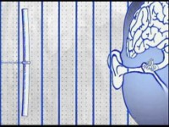
What is sound?
Result of vibrations in the air caused by pressure fluctuations.
The vibrations are then perceived by the auditory system.

Slide 3
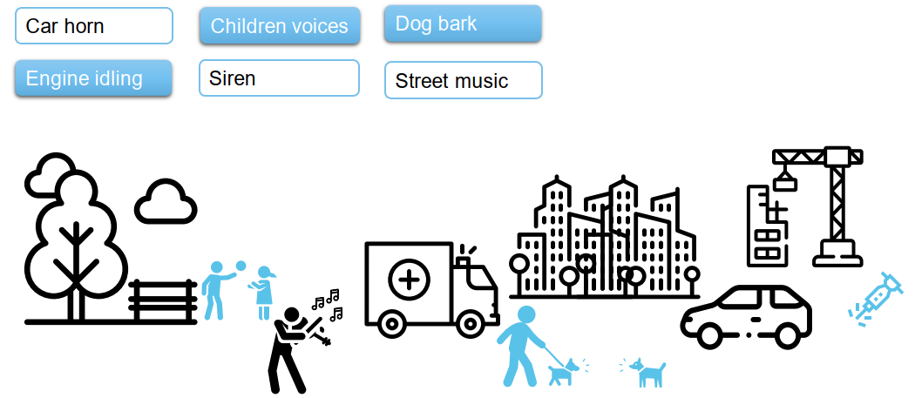
What sound indicates?
Information about everyday events and scenes.
Provides informative signals of events happening in the surrounding environment.
Sound event: specific sound produced by a distinct physical sound source.
Car passing by, bird singing, doorbell …
Sound scene: sound that is form when sounds from various sources combine to form a mixture.

Slide 4
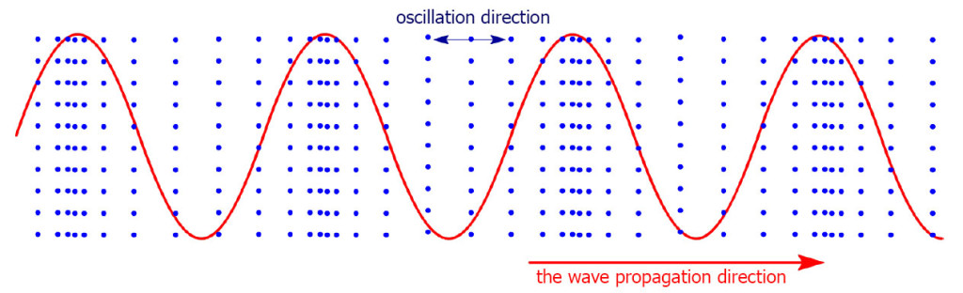
Waves in the air
Sound is a wave that travels in an elastic medium.
If the medium is air: then it is a longitudinal wave in which change in the local density of the air is propagated.
The direction of the particle velocity or displacement of a longitudinal wave is parallel to that in which the wave is travelling.

Slide 5
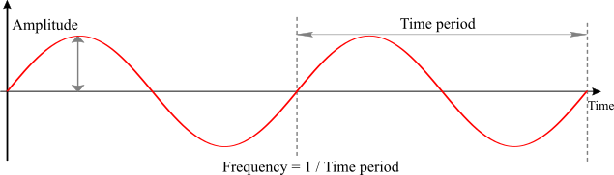
Characteristics of sound
Wavelength is the horizontal distance between two successive equivalent points on the wave.
Period (in s) is the duration needed to travel a distance of one wavelength.
Amplitude of the pressure, air pressure oscillations.
Frequency (in Hz) the inverse of the period.

Slide 6
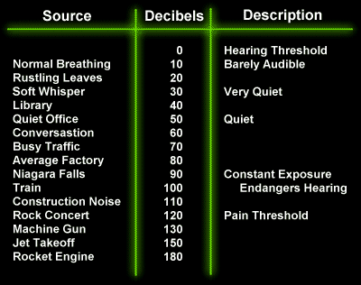
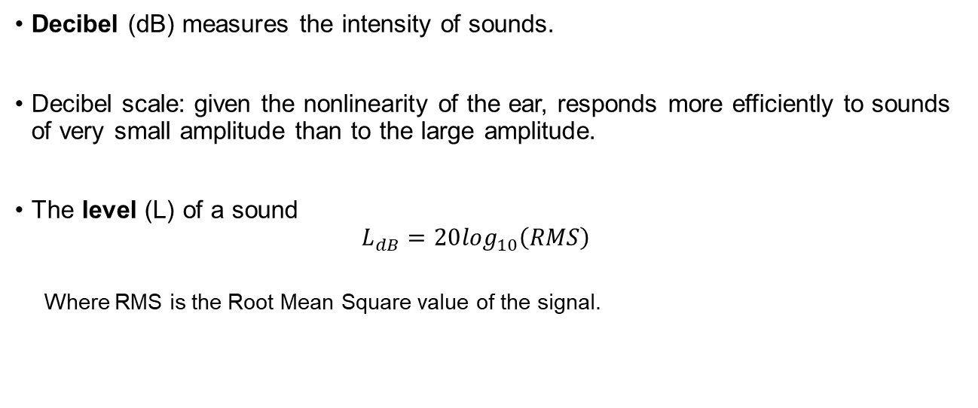
Characteristics of sound
Decibel (dB) measures the intensity of sounds.
Decibel scale: given the nonlinearity of the ear, responds more efficiently to sounds of very small amplitude than to the large amplitude.
The level (L) of a sound
$$L_{dB}=20\log_{10}\left(RMS\right)$$
Where RMS is the Root Mean Square value of the signal.
https://www.schoolnet.org.za/PILAfrica/en/webs/19537/physics8.html

Slide 7
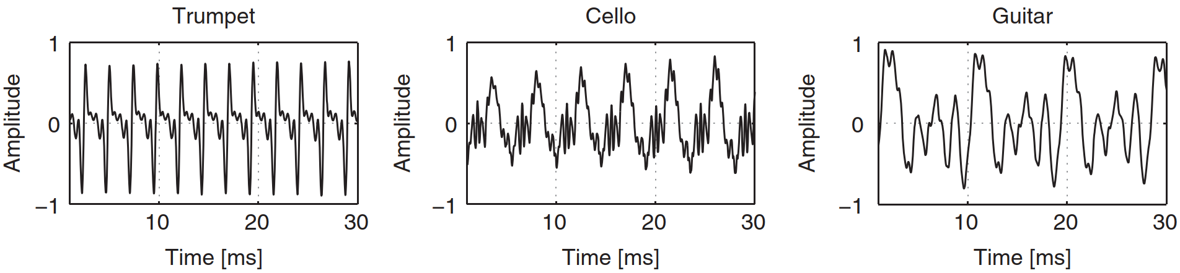
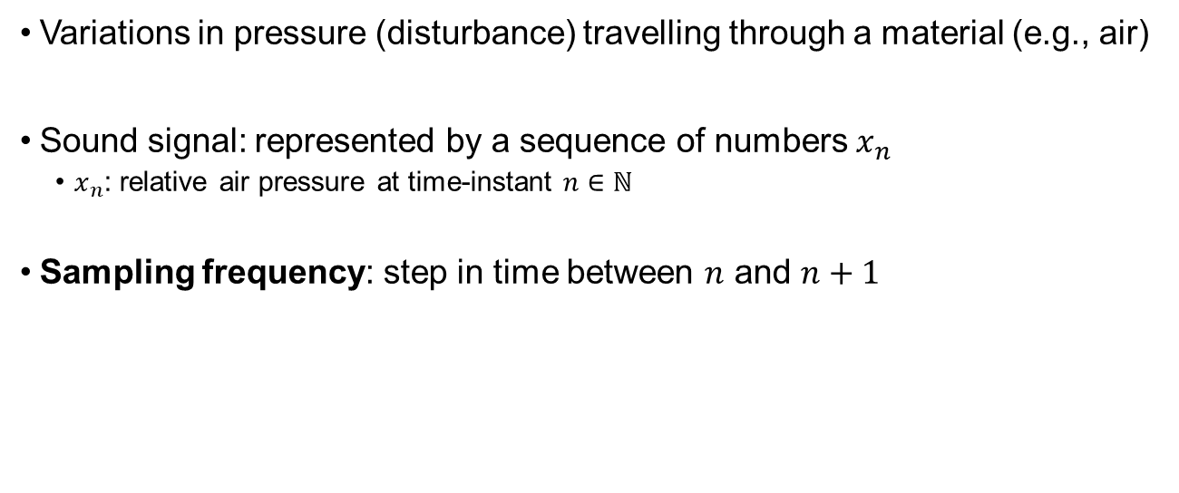
Waveform
Variations in pressure (disturbance) travelling through a material (e.g., air)
Sound signal: represented by a sequence of numbers $x_{n}$
$x_{n}$: relative air pressure at time-instant $n∈ℕ$
Sampling frequency: step in time between $n$ and $n+1$

Slide 8
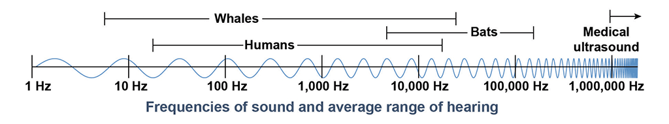
Frequencies
Human hearing: 20 Hz- 20kHz
Infrasound: below 20 Hz – Natural events, animal communication, human-created sources.
Ultrasound: higher than 20kHz – animal communication, medical and industrial sources.
https://www.pasco.com/products/guides/sound-waves

Slide 9
Audio signal representation
In order to represent sound signals, a numerical representation is used, in a form of a vector.
Digitalize:
Requires sampling, quantization.
Used for store, send, manipulate, etc. the signal.
Can be converted back to analog if needed.

Slide 10
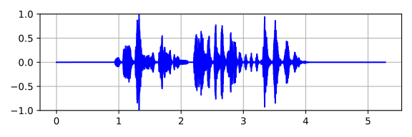
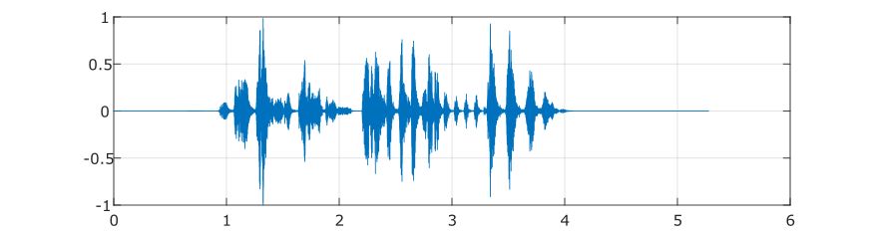
Digital representation
Python
Matlab
from scipy.io.wavfile import read
import matplotlib.pyplot as plt
# Read audio
sr,s = read('bird_ex.wav')
t = np.linspace(0, len(s)/sr, len(s), endpoint=False)
plt.figure(figsize=(6,2))
plt.plot(t,s, c='b')
plt.grid()
plt.show()
[y,Fs] = audioread('bird_ex.wav');
y = y(:,1);
dt = 1/Fs;
t = 0:dt:(length(y)*dt)-dt;
plot(t,y);
grid on

Slide 11
Python for audio
Write audio file
from scipy.io.wavfile import write
import numpy as np
# Write audio
sr,s = read('bird_ex.wav')
t = np.linspace(0, len(s)/sr, len(s), endpoint=False)
write('bird_sound.wav’, sr, s.astype(np.int16))
Read audio file (another way)
import librosa
# Read audio
y,sr = librosa.load('bird_ex.wav’)
If sr is not specified, it will be automatically resampled to sr=22050.
Automatically normalized the data (between -1 and 1).

Slide 12
Python for audio: play audio file
import sounddevice as sd
import soundfile as sf
data, fs = sf.read('bird_ex.wav’)
sd.play(data,fs)
SoundFile used by librosa. It can open WAV, FLAC, OGG and MAT files
import sounddevice as sd
From scipy.io.wavfile import read
sr, s = read('bird_ex.wav’)
sd.play(s,sr)

Slide 13
Audio and speech processing
Audio coding:
mp3
speech encoding on mobile phones.
Modifications:
Enhancement
Equalization
Denoising
Echo cancellation
Audio content analysis:
Artist
Music genre
Fingerprinting
Speech recognition

Slide 14
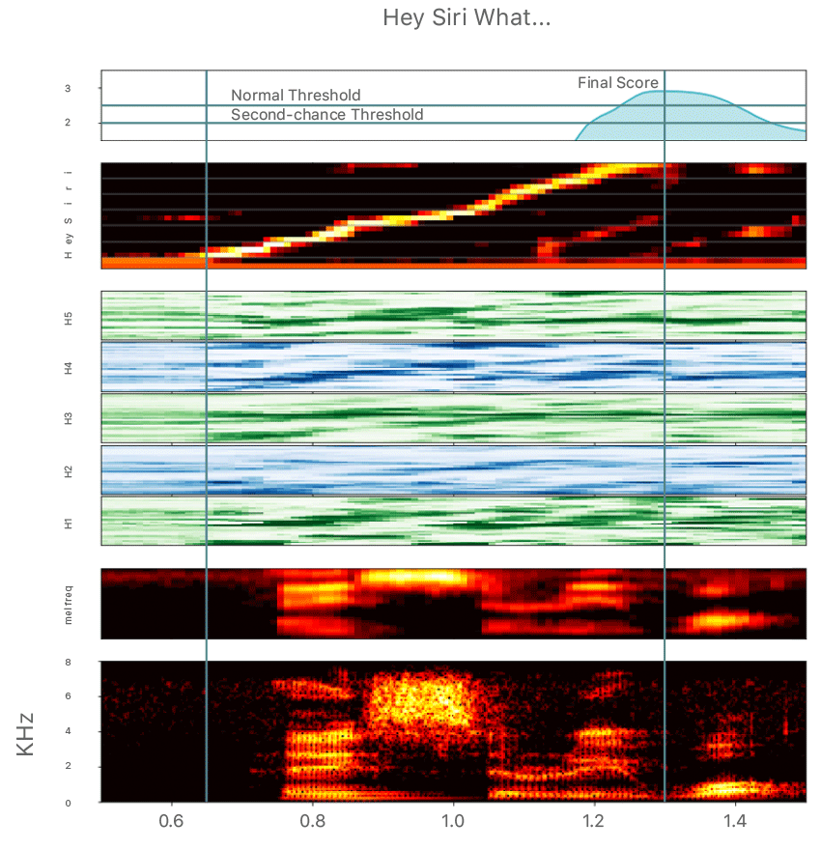
Speech processing
Example of application:
DNN convert the acoustic pattern of the voice into a probability distribution to detect when the speaker says, “Hey Siri”.
https://machinelearning.apple.com/research/hey-siri

Slide 15
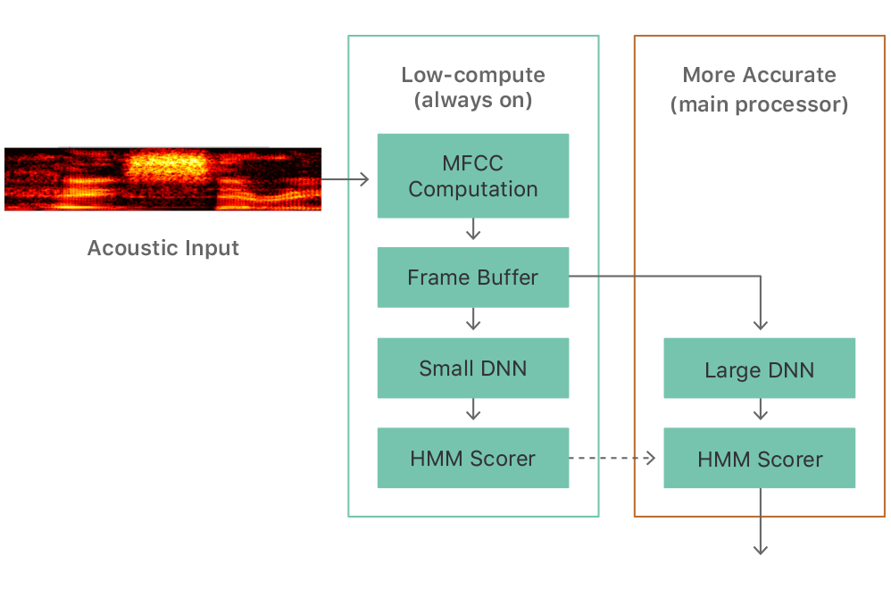
Speech processing
Sampling frequency = 16000 Hz
Calculates spectrogram with window size of 0.01s
It calculates the MFCC, which gives weight to frequencies based on perceptual measurements.
Feed the neural network with 20 frames, so 0.2s

Slide 16
Audio fingerprinting
Deterministically generated digital summary that can be used to identify audio samples in a database.
Application examples:
Shazam
Midomi (sing, hum or whistle)
SoundHound
Musixmatch
TuneFind

Slide 17
Thinking break
Can you tell other examples of audio processing that you know of? Or that you have encountered in everyday life?

Slide 18
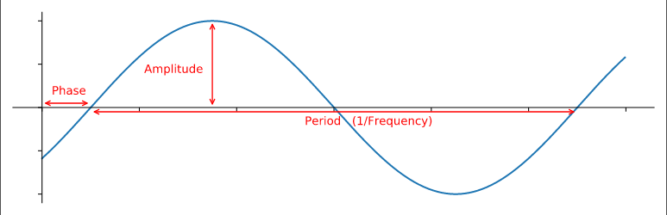
Time domain representation
We sample signals in the time domain, its natural form.
Frequency: number of waves per second.
Amplitude: “Strength” of the wave.
Phase: how the wave is shifted in time.

Slide 19
Sampling and Sampling frequency
Sampling is the process of measuring the value of a continuous signal in fixed time intervals.
Continuous → Discrete
Sampling frequency (also called sampling rate) is the number of samples taken per second when performing the sampling process.
Examples
CD quality audio = 44100 samples per second (44.1 kHz)
High quality audio = 192000 samples per second (192 kHz)
For speech only = 16000 samples per second (16 kHz)

Slide 20
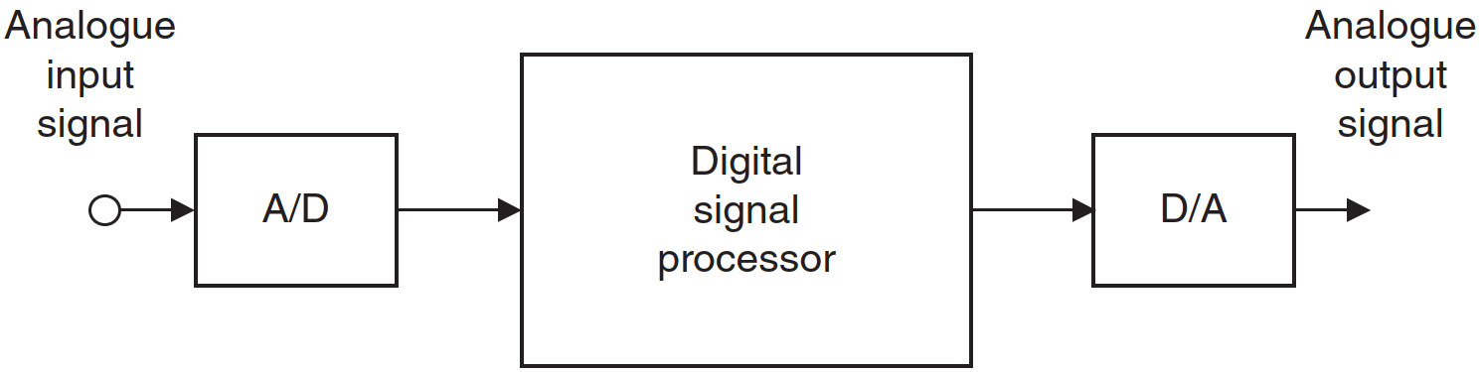
Sampling and signal conversion
Sampling rate determines the highest frequency that can be captured from the signal.
If not → aliasing will occur.
Nyquist limit: half of the sampling rate.
Higher limit = will not capture more information and increase computational cost.
Lower limit = information loss. E.g. speech sampled at 8 kHz will sound muffled.
5 seconds audio clip at 8 kHz results in 40000 values.
Same 5 seconds but at 16 kHz results in 80000 values.

Slide 21
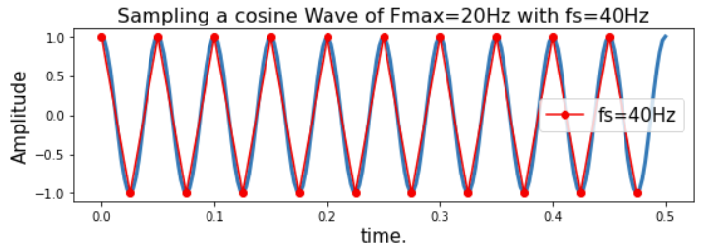
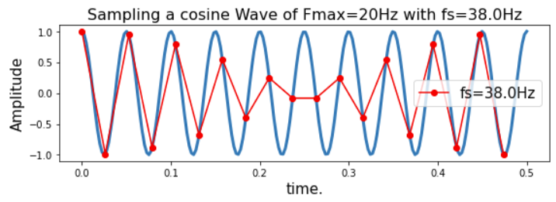
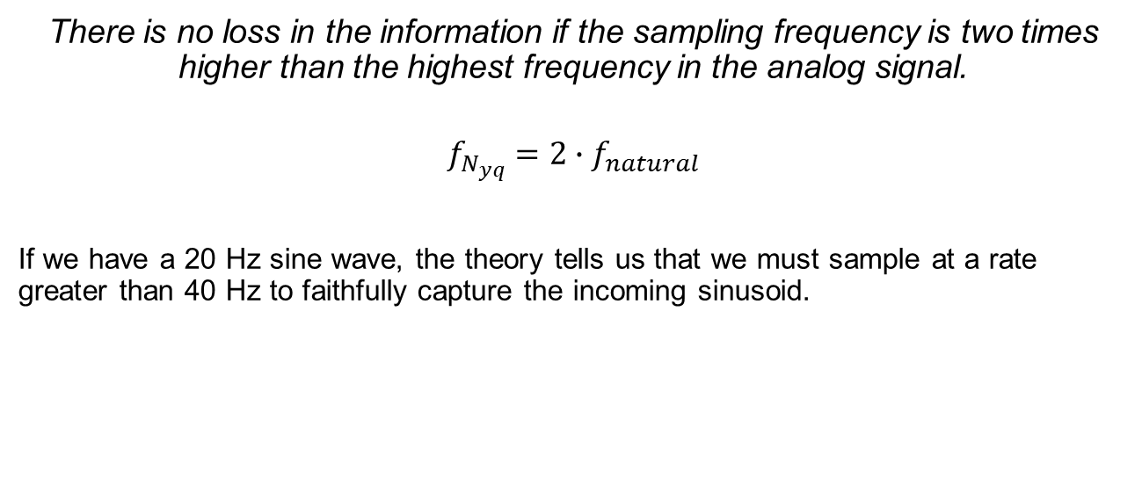
Nyquist-Shannon sampling theorem
There is no loss in the information if the sampling frequency is two times higher than the highest frequency in the analog signal.
$$f_{N_{yq}}=2∙f_{natural}$$
If we have a 20 Hz sine wave, the theory tells us that we must sample at a rate greater than 40 Hz to faithfully capture the incoming sinusoid.

Slide 22
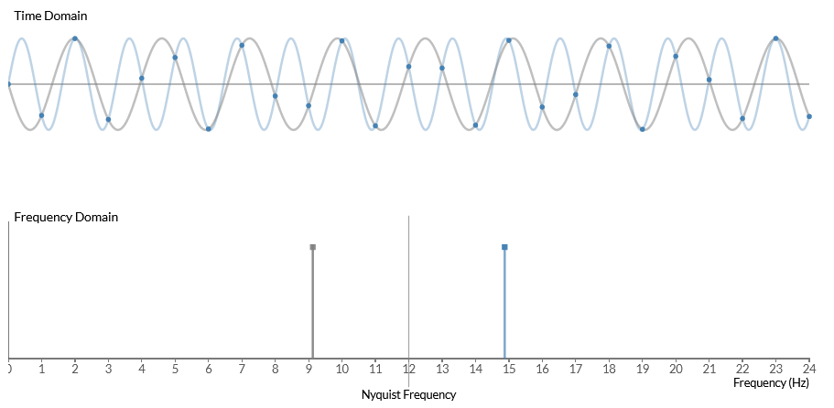
Nyquist frequency
Once the Nyquist limit is crossed, the sampled signal is a valid representation for the input wave (blue, ~ 15Hz) and for another sine (grey, ~9Hz) wave, with smaller frequency.
Sampling rate: 24 Hz
Nyquist limit: 12 Hz
In this scenario the sampling rate is fixed and the input signal is varying its frequency.

Slide 23
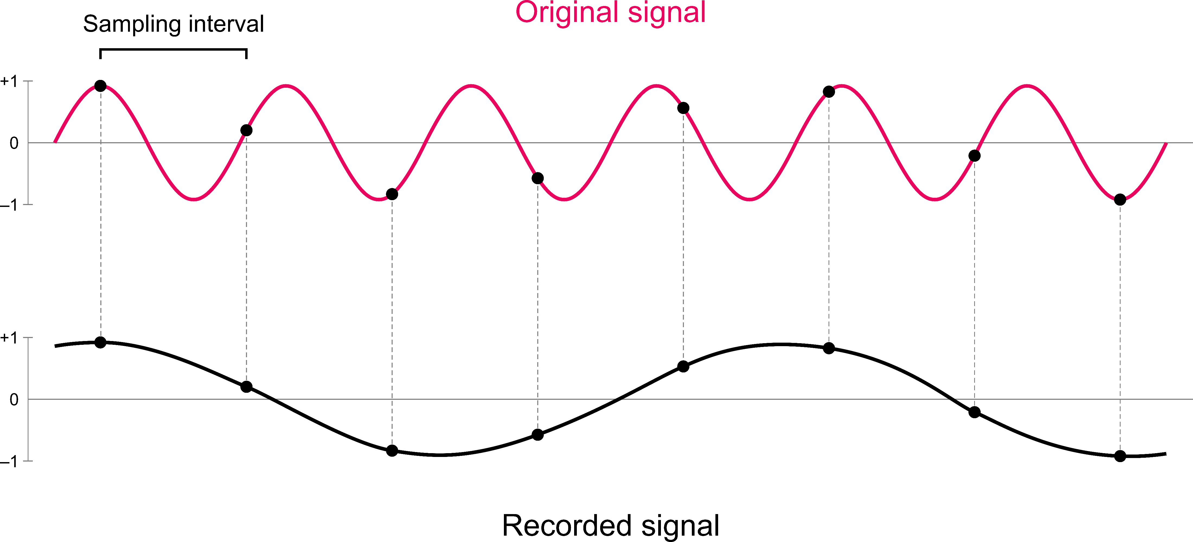
Sine wave aliasing
A sine wave at frequency of F is indistinguishable from a sine wave at a frequency of F+(k x Sampling Rate) after sampling.
Animation [here]
By Laurens R. Krol - Own work, CC0, https://commons.wikimedia.org/w/index.php?curid=96867752

Slide 24
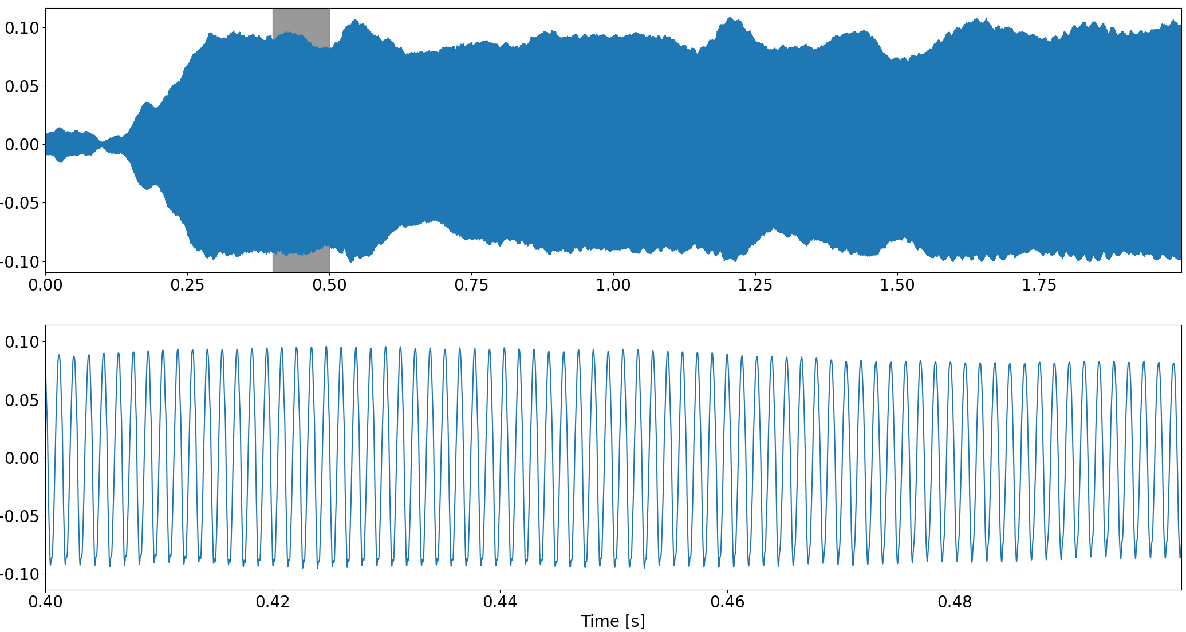
Example: Flute
First panel: Two seconds Sol note.
Second panel: signal zoomed in 100 ms (0.4 – 0.5 s).
Many natural sounds are periodic and most musical instruments and vowels in speech.

Slide 25
Upsampling and Downsampling
Upsampling: calculate additional sample values in between the already extisting ones.
Downsampling:
First make sure that there are no frequencies higher than the new Nyquist theorem.
Estimate the new sample points.
Downsampling by a factor of 2 ≠ throwing away every other sample.

Slide 26
Amplitude
Sound is changes in the air pressure at frequencies audible to humans.
The amplitude describes the sound pressure level at a given instant.
It is measured in decibels (dB).
Bit depth: determines the precision in which the amplitude value will be stored.
The higher the bit depth, the more precise the representation will be.

Slide 27
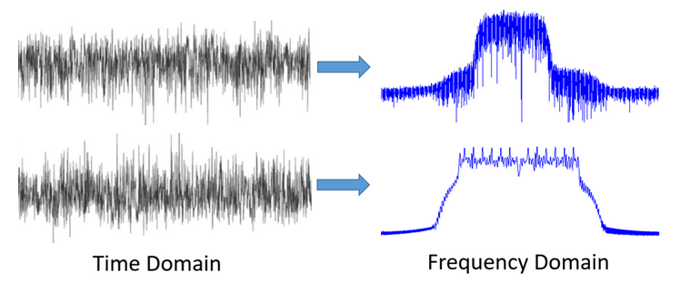
Time vs Frequency domain
Frequency domain is more informative than Time domain.

Slide 28
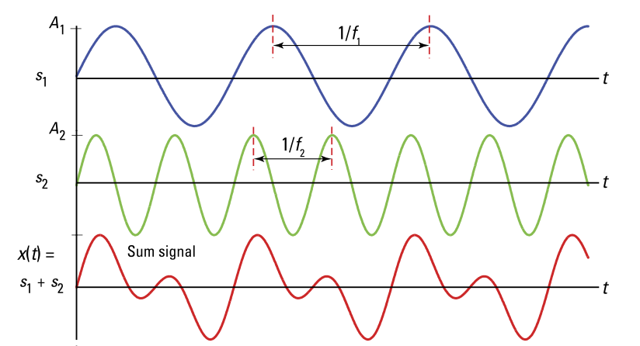
Frequency domain representation
Fourier series state that: periodic functions can be written as sum of simple waves mathematically represented by sines and cosines.
A periodic signal can be decomposed as a sum of sinusoids.

Slide 29
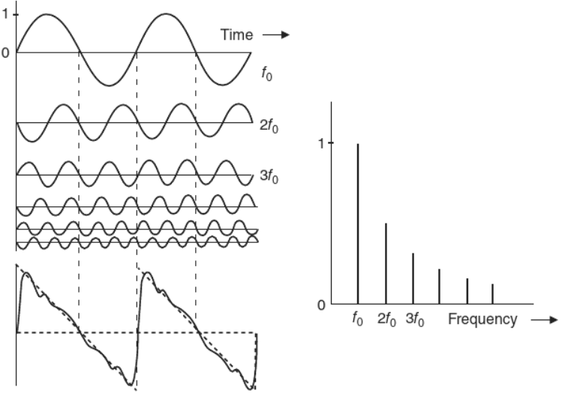
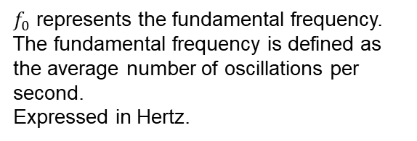
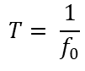
Another example
$f_{0}$ represents the fundamental frequency.
The fundamental frequency is defined as the average number of oscillations per second.
Expressed in Hertz.
The length of a single period in seconds is:
$$T= \frac{1}{f_{0}}$$

Slide 30
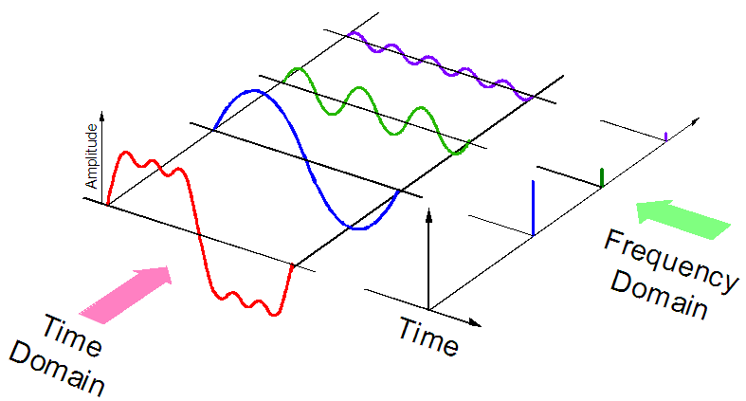
Fourier Transform
Decomposes a signal into its constituent sinusoids.
The original (red) waveform, it is depicted with its component frequencies. The fundamental frequency (f0) is the blue one, the second harmonic (green) Will be at frequency 2*f0 and the third harmonic at frequency 3*f0.

Slide 31
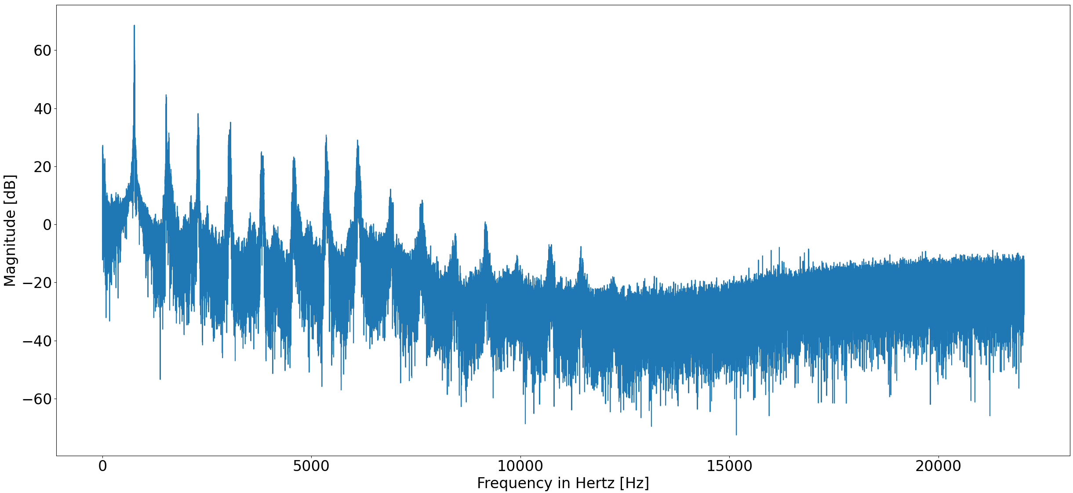
Discrete Fourier Transform (DFT)
For practical applications the DFT is the transform used to perform Fourier analysis. Finite time intervals are used in digital signal processing.
When computing the DFT the algorithm applied is called Fast Fourier Transform (FFT).
Many important properties are more clearly visible in frequency domain:
Magnitude on logarithmic scale, which is motivated by human hearing and dynamics of natural sounds.

Slide 32
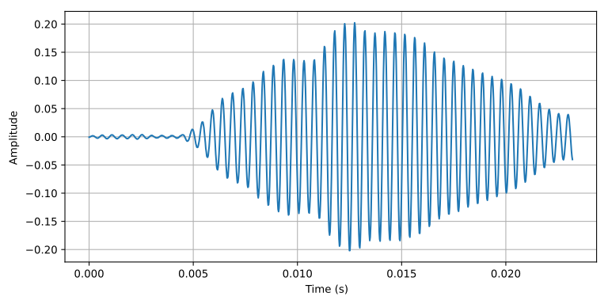
Python FFT
from scipy.io.wavfile import read
from scipy.fftpack import fft
from scipy import signal
SciPy: Scientific Python, a computation library that uses NumPy underneath.
win_size = int(0.1*sr) # window size
window = signal.hamming(win_size) # window function
hop_size = win_size//2 # hop size
Frame with windowing (hamming) from a bird song.

Slide 33
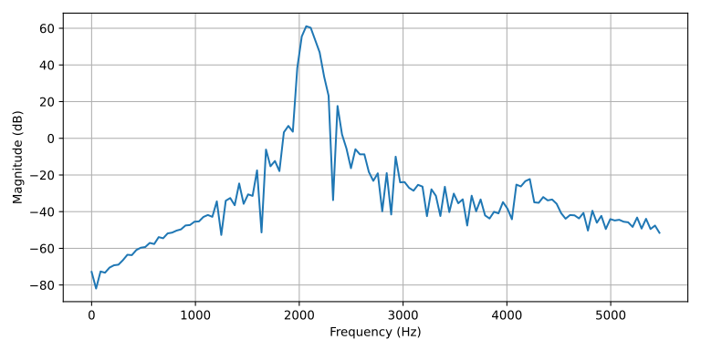
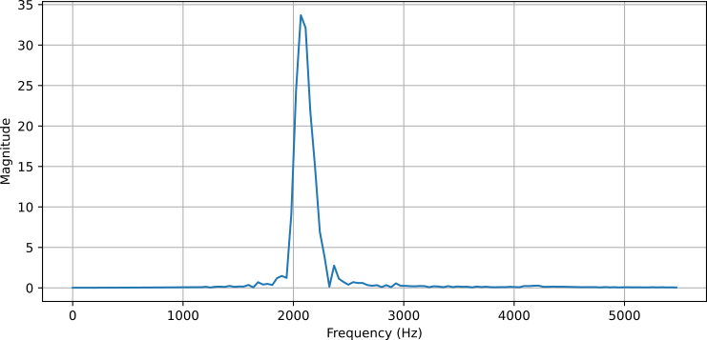
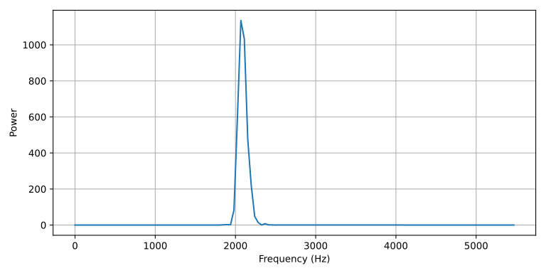
Python spectrum
Log-spectrum
Magnitude of DFT
Power of DFT

Slide 34
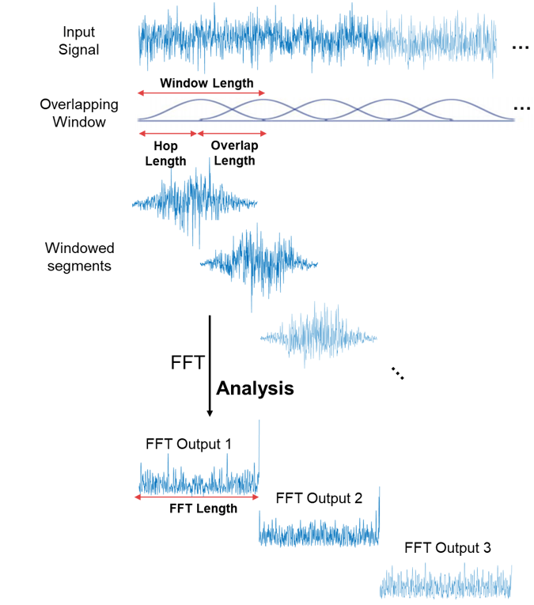
Spectrogram
Sound power as a function of time and frequency.
Steps to calculate it:
Split into short analysis frames (10-100 ms), called windowing.
For each frame the spectrum is calculated (DFT).
The result is concatenated in time to form a matrix.

Slide 35

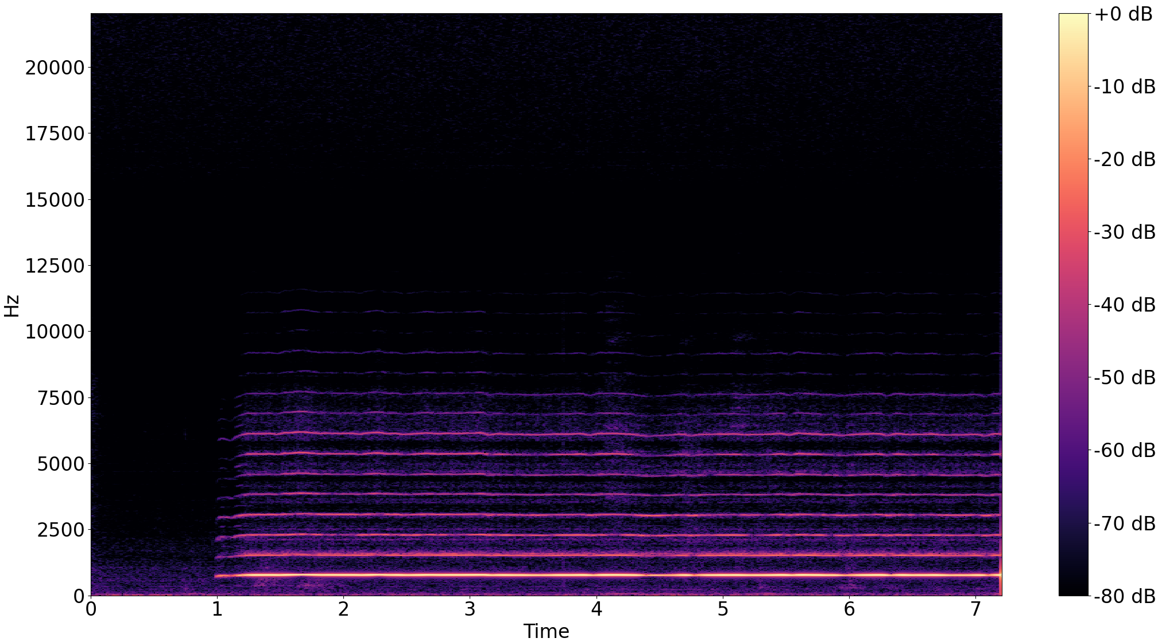
Examples
Spectrogram of the sol note played with a flute.
Parameters:
Window length
Hope size
Sampling frequency

Slide 36
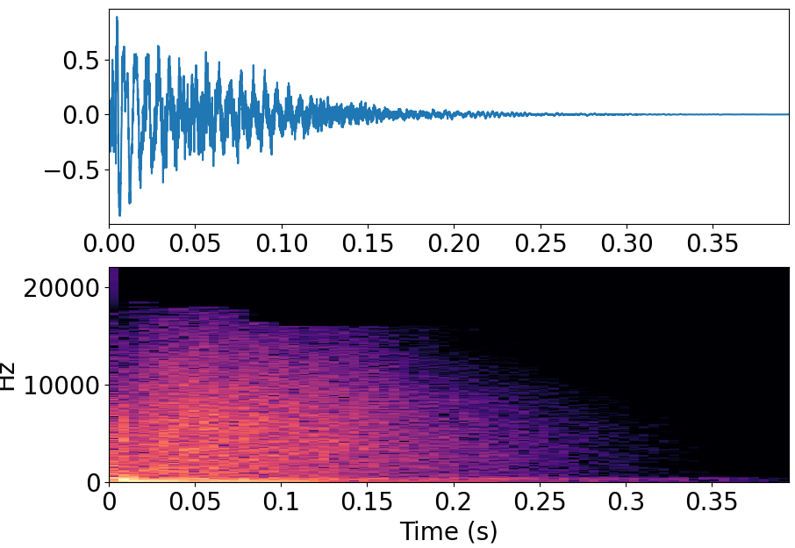
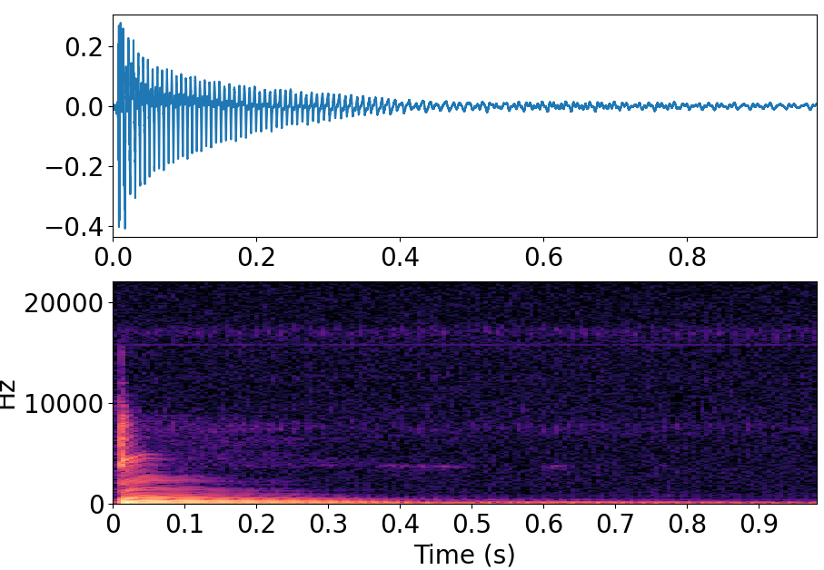
Examples
Instantaneous excitation sounds decays gradually.
Snare drum
Guitar (plucked string)

Slide 37
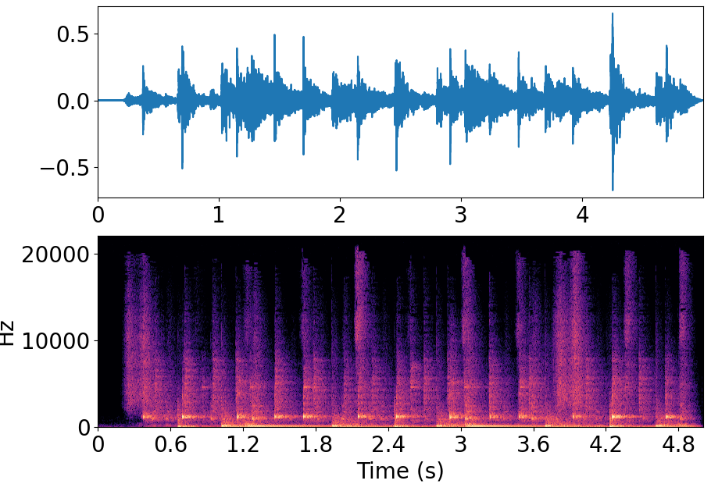
Examples
Polyphonic music
Mix of several instruments as a linear superposition

Slide 38
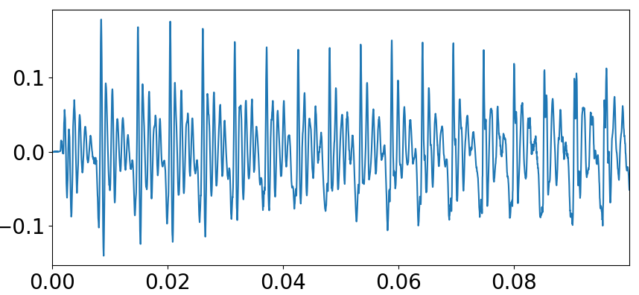
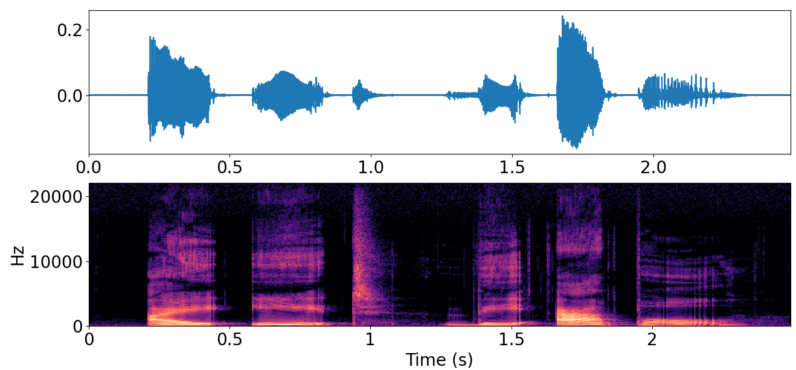
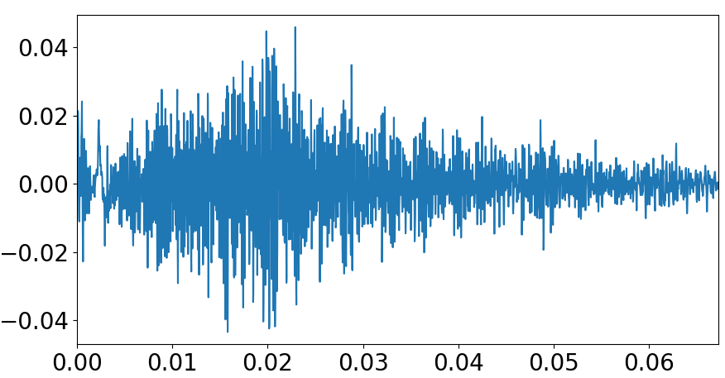
Examples
“I” voiced: periodic
“I eat the apple”
Speech: sequence of individual sounds (phonemes).
Each phoneme has its characteristic spectral shape.
“t” in “eat” unvoiced: noisy

Slide 39
Summary
Sound and vibration → more in Lecture 2
How sound propagates
Sampling theorem
Time domain representation → more in Lecture 6
Frequency domain representation → more in Lecture 4 and 5

Slide 40
Extra material
How hearing Works:
Journey of Sound to the Brain - YouTube
Interactive web page to learn about digital signal processing concepts:
https://jackschaedler.github.io/circles-sines-signals/index.html
Videos to understand Fourier transforms:
Drawing with circles

